Slide 1
The Triton Final Design Review
Team 25
Notes:
Speaker: Diego

Slide 2
Introduction
The Triton is a docking assistant which can also help with nautical navigation
Helps sailors of all skill levels to safely navigate and dock boats
Designed to last long trips, and to withstand even the roughest conditions.
Our product is integrated and multi-functional, cost-efficient, not specific to any vessel
Notes:
Speaker: Matthew
Refine
From Matthew: Made it more concise and more relevant to the current iteration of product.

Slide 3
Problem Statement
Sailing in a crowded harbor or racing alongside other boats in close proximity is challenging,
Skipper's field of view is blocked by the main and front sails,
Docking can be difficult and dangerous to the skipper, under many conditions, such as unfavorable wind direction, current, or limited visibility.
In 2023 the United States Coast Guard reported that the top three causes for recreational boating accidents were operator inattention, improper lookout, and operator inexperience.
Also in 2023, there were 564 deaths and 63 million dollars in damages due to boating related accidents.
We want to fix this problem!
Notes:
Speaker: Diego
Refine
Matthew: Looks good?

Slide 4
Requirements
The system will collect wind speed, speed over ground, and speed through water.
The sensors will send updates to the central processor at least every one (1) second while a trip is in progress.
The proximity cameras will detect obstacles between one (1) meter and twelve (12) meters away
All physical components of the system, including housing, will weigh less than twenty-five (25) pounds in total.
The battery for the system will last at least twelve (12) hours on a full charge.
The system will be easily mounted to any sailboat. It will have adjustable clamps to fit onto different parts of the boat.
Weatherproof rating of at least IP68.
The system will be resistant to harsh weather conditions.
GPS accurate within twenty (20) meters.
Notes:
Speaker: Diego
Refine and update

Slide 5
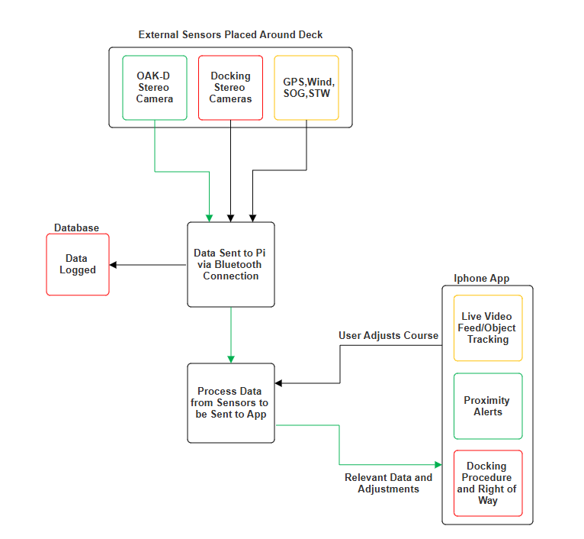
System Block Diagram
External sensors will relay data via Bluetooth to the Pi
The Pi will then process the relevant data and send warnings and adjustments
The user will then be able to make adjustments or pull up a live feed to assess the situation and make the appropriate response in turn
Notes:
Speaker:Kevin
Needs to be Updated
Change Radar/Nav to GPS/SOG
Take SOG out of Wind, SOG, SOW block
What does docking system mean? Cameras?
Change Data sent to main system to Data sent to Raspberry Pi

Slide 6
Technology/Design

Slide 7
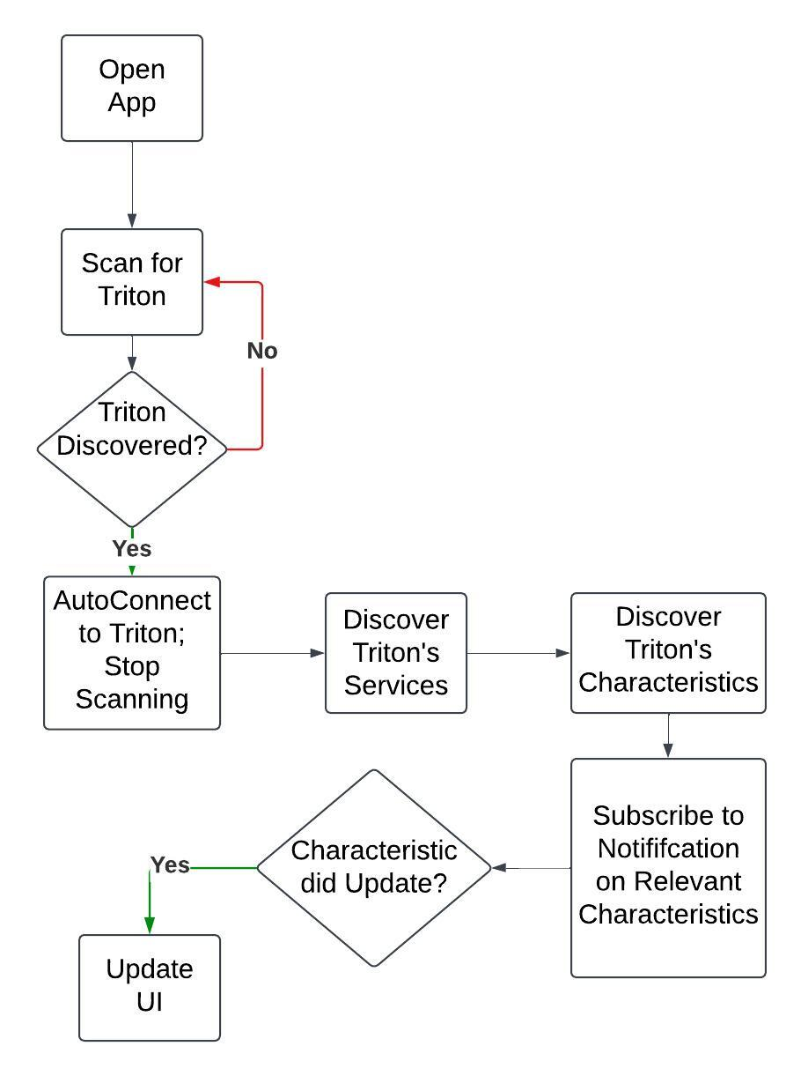
Bluetooth Connection Overview: iOS
Notes:
Speaker: Kyla
This is our iOS app connection Used CoreBluetooth to build out the Bluetooth functionality of the App (Framework provided by Apple)
When you open the app, it will automatically start scanning for the Triton
Scans for a custom 16-bit advertising UUID
Once triton is discovered, it will auto-connect to the device
Once connected, the app will discover the services hosted on the Triton’s GATT server
Once the services are discovered, it will go through each service and discover the service’s characteristics
While it is discovering characteristics, it will compare the UUIDs of the characteristics to a predetermined list of characteristics we’re looking for. If the UUID matches one of the characteristics we’re looking for, then we’ll subscribe to notifications on thar characteristic
From here, if the value of the characteristic updates on the Triton, then the iOS app will be notified and will update the UI with the corresponding values as soon as the notification is received iOS app is the GAP (generic access profile) central and the GATT (generic attribute profile) client

Slide 8
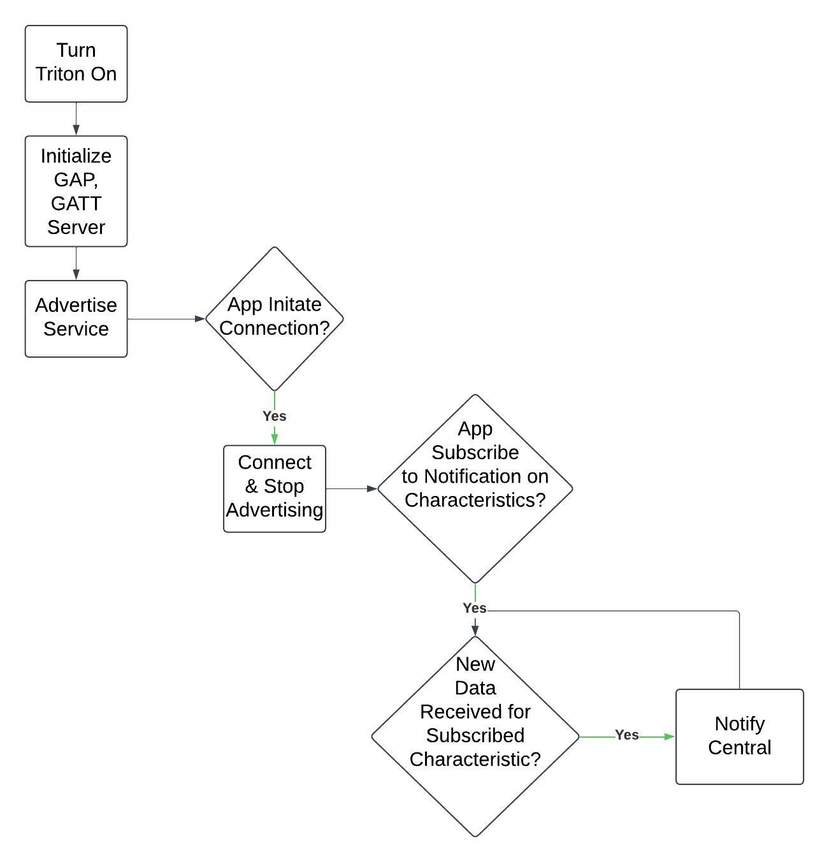
Bluetooth Connection Overview: Triton/Raspberry Pi
Notes:
Speaker: Kyla
This is our Triton connection Used Bluez (Linux BT Protocol Stack) to build out the bluetooth functionality of the Triton
When the Triton is on and running the python script, it will initialize and register the gatt services and characteristics that the iOS app will discover
The triton then begins advertising the UUID designated for advertising
Once triton is discovered, it will auto-connect to the device and stop advertising
When the app initiates the connection, the Triton will connect to the iOS app
The iOS app will then discover the Triton’s services and characteristics (this can only happen after the two are connected)
The iOS app will then subscribe to notifications on each of the characteristics
If new data is received for the characteristic values, then the value of the characteristic will be updated and the iOS app will be notified Triton/RPi app is the GAP (generic access profile) peripheral and the GATT (generic attribute profile) server

Slide 9
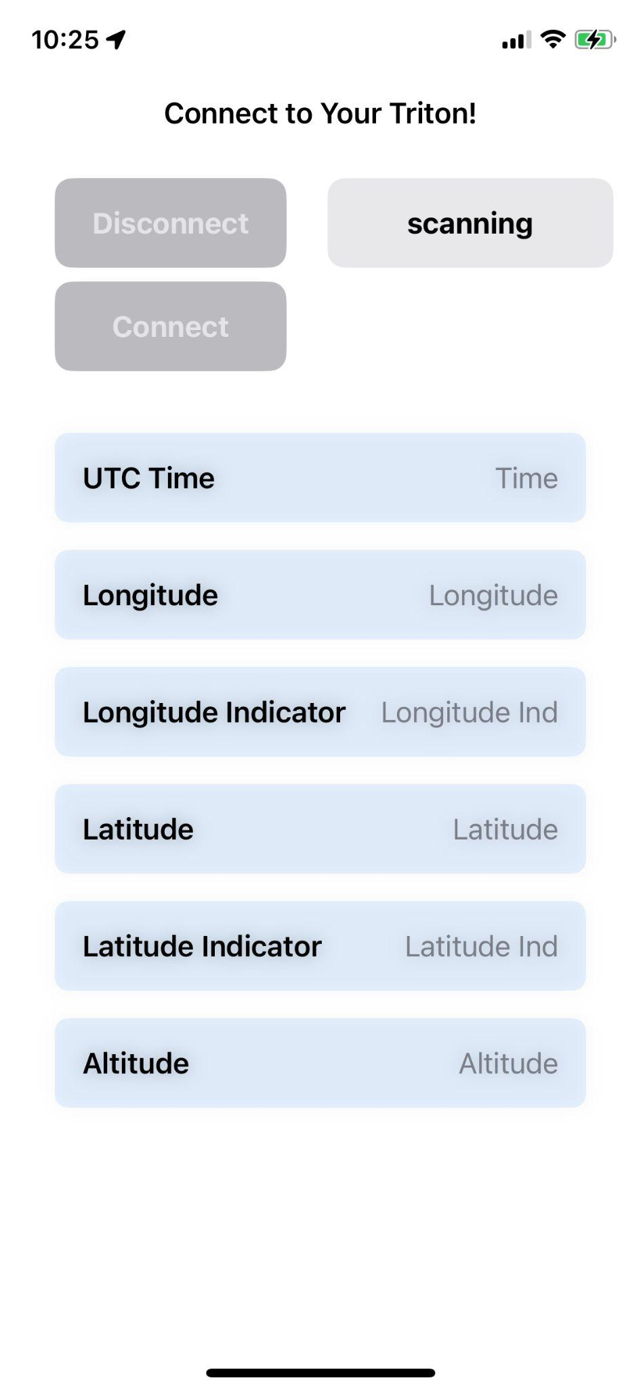
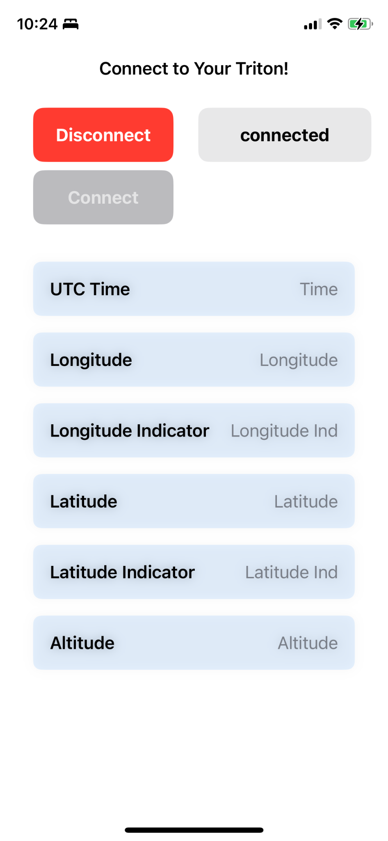
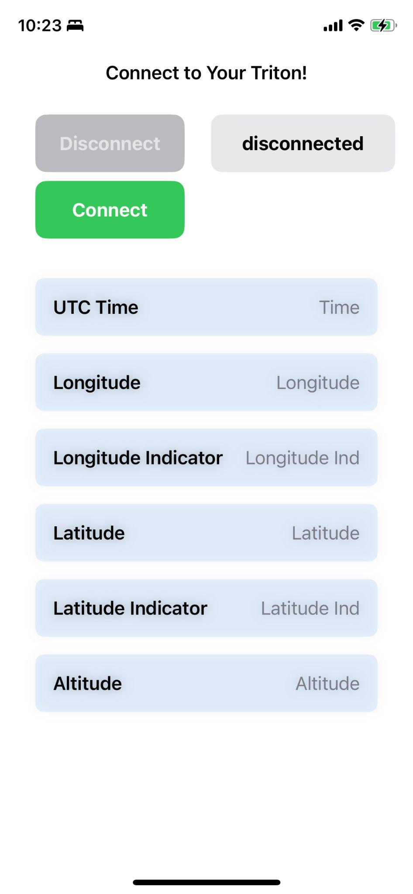
iOS App User Interface
SwiftUI
Button
HStack
VStack
Notes:
Speaker: Kyla
App interface once the Triton has connected to the iOS app and is sending GPS data Created using SwiftUI
Buttons
Tiles

Slide 10
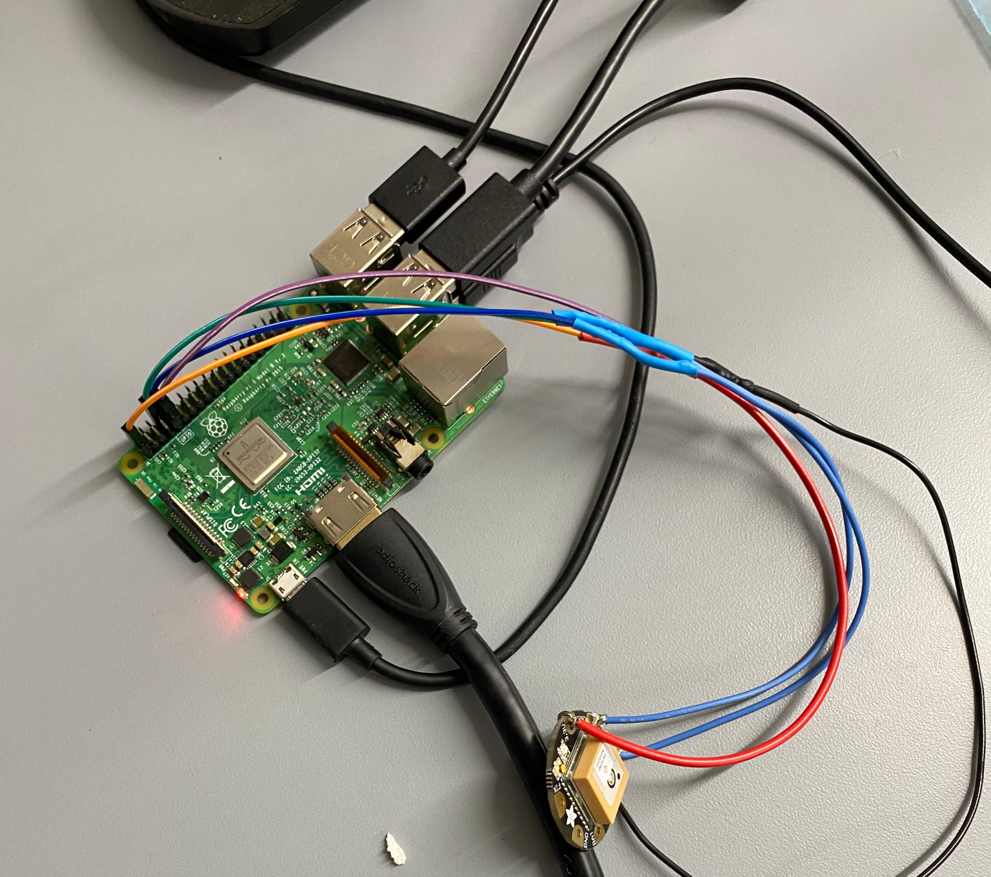
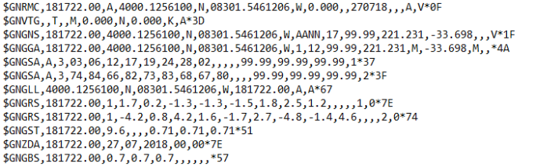
GPS Module
Transmits signals and receives data from multiple satellites
Output of NMEA Data
Data includes:
Date
UTC Time
Latitude
Longitude
Altitude
Speed Over Ground
Course Over Ground
Notes:
Speaker: Leyandra GPS Module: Sends data to the Raspberry Pi through wired connections then Raspberry Pi sends the data from the module to the app. The data sent includes the UTC time, current date, latitude, longitude, altitude, speed over ground, and course over ground.

Slide 11
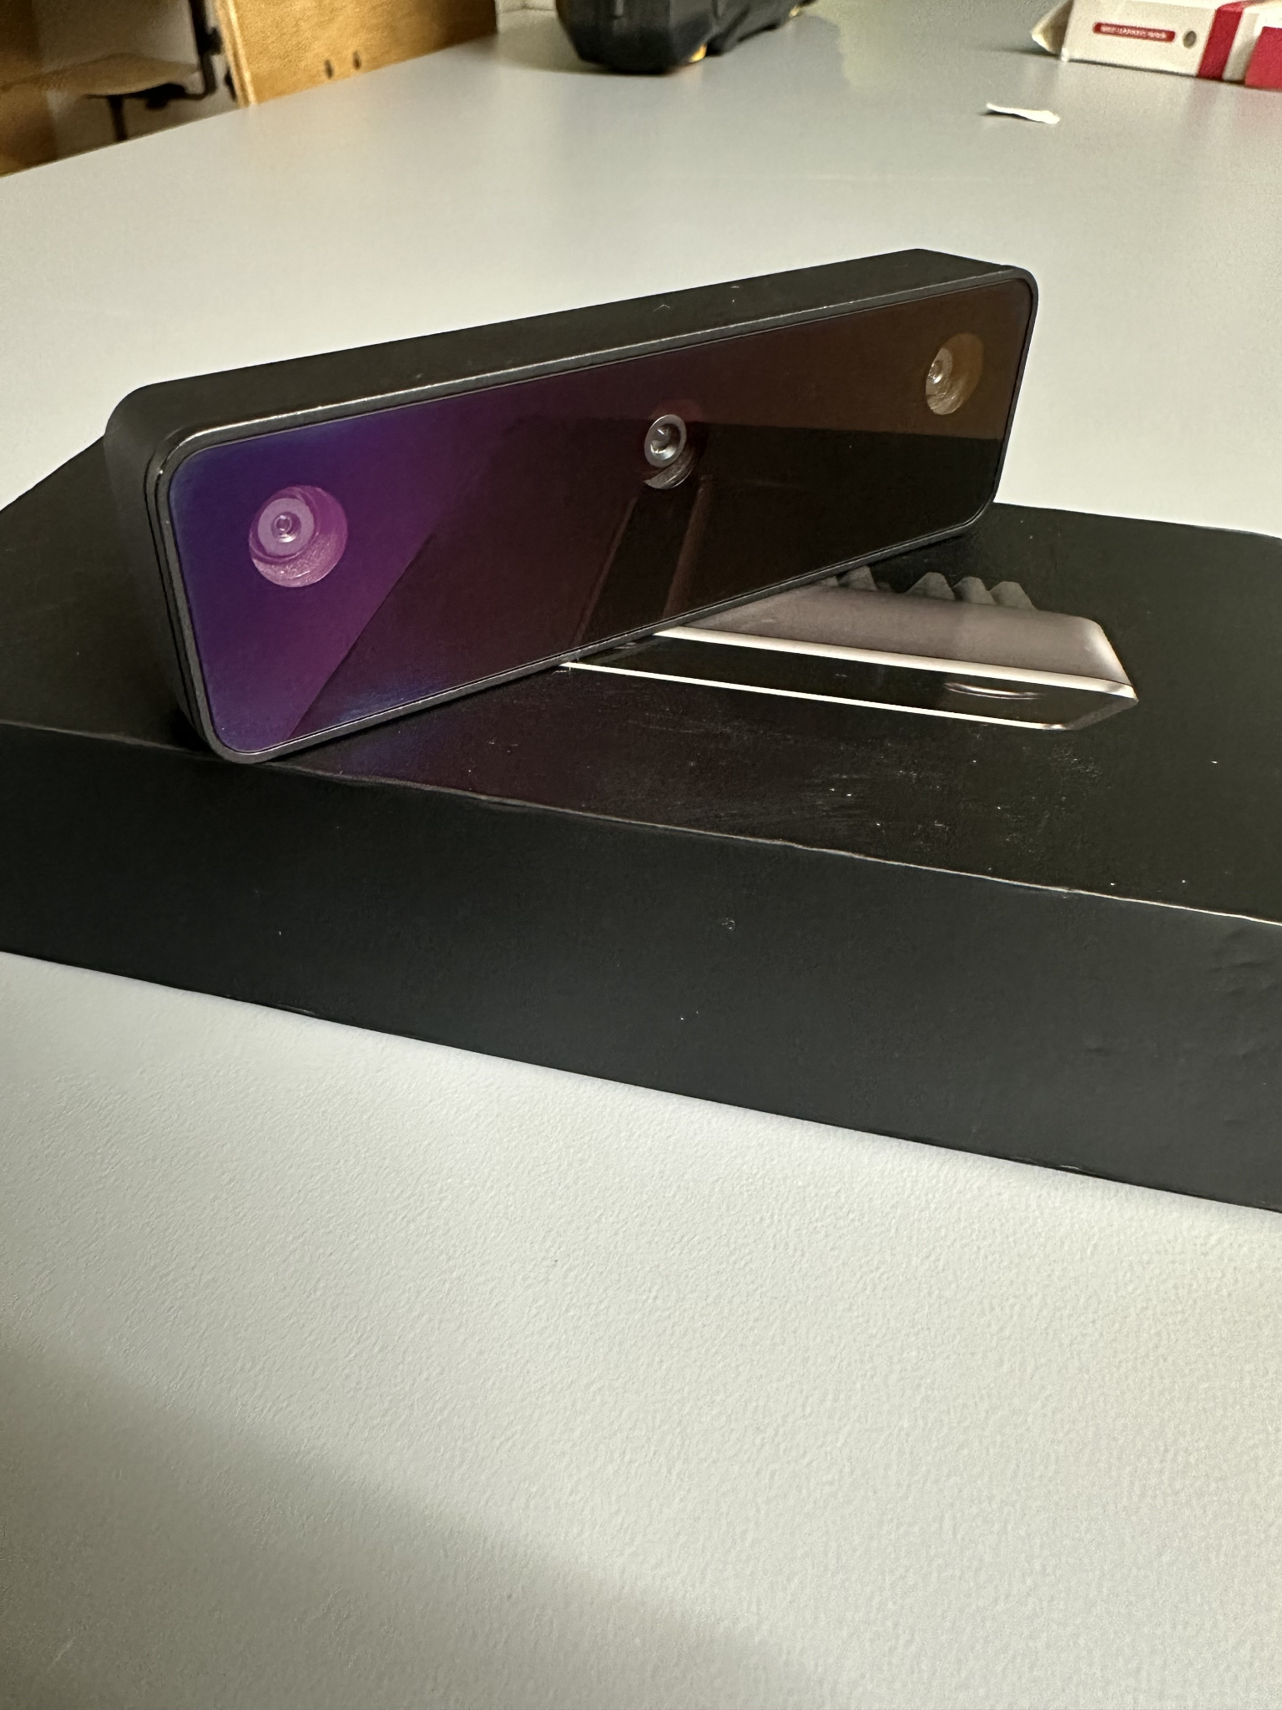
Oak-D Camera
Currently our prototype is able to detect and measure the distance of objects reliably up to 12 meters away and can alert of nearby objects and their relative position to the camera
We plan to train the camera through machine learning to recognize other ships and common obstacles found while sailing
Upon recognizing an obstacle the user will be alerted and given the option to view the object and to have the Oak-D camera then physically track the object
The Oak-D will be mounted onto a motor that will allow it to follow detected objects, as well as scan and increase the FOV of our system
Notes:
Speaker: Kevin
OAK-D Camera: The camera is directly connected to the Raspberry Pi, which will send object detection data to the phone as well as a live photo on an interval

Slide 12
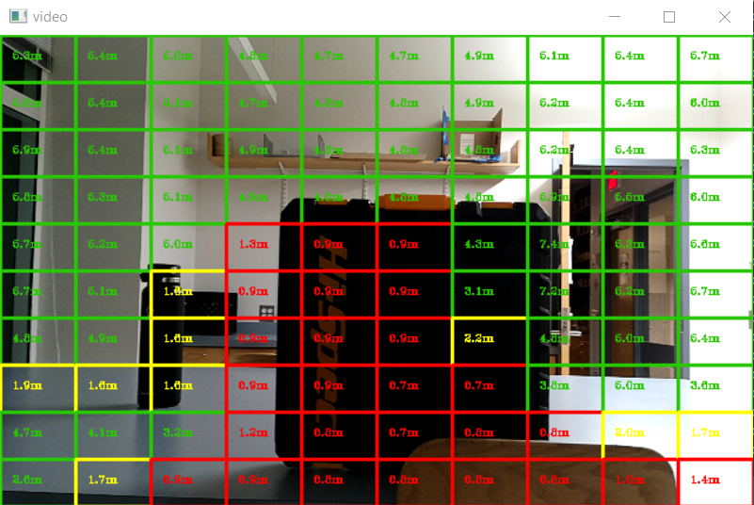
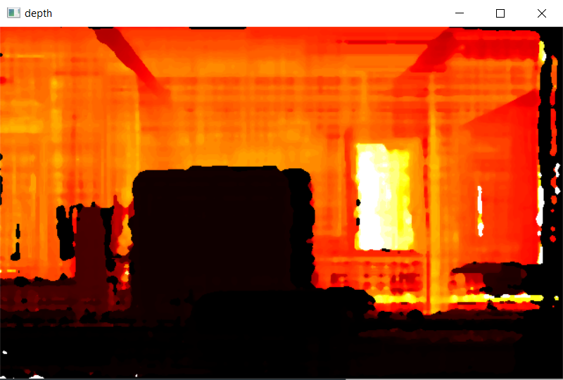
Oak-D Camera (Cont)
Notes:
Speaker Kevin

Slide 13
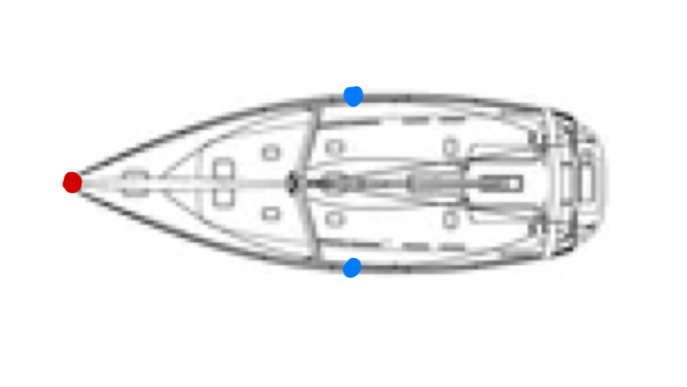
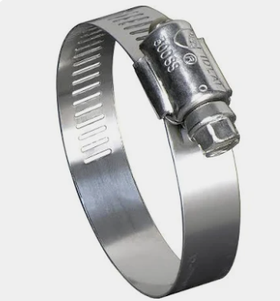
Housing
Devices placed on three main points of the boat
Front
Oak-D camera
Anemometer
GPS Module
Left and Right
Stereo Pi Cameras
Mounting systems with clamps
Oak-D motorized swivel as an attachment to the Oak-D housing
Stepper Motor
Servo Motor
Brushless Motor
Notes:
Speaker: Ley

Slide 14
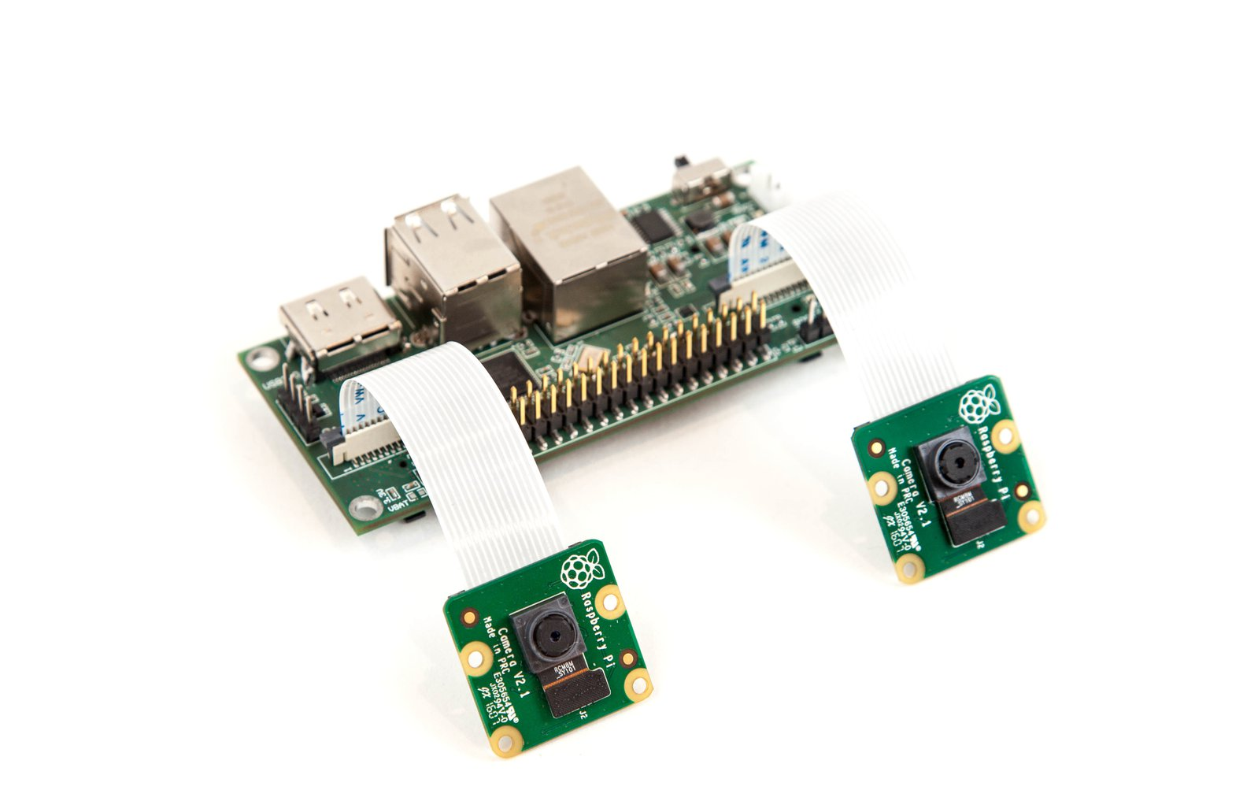
Stereo Cameras
Notes:
Speaker: Kyla In order to enable depth perception on either side of the sailboat, we will mount a stereo camera on the widest part of the sailboat on starboard and port. We will use 4 raspberry pi cameras, 2 stereopis, and 2 raspberry pi compute module 4s to enable 2 stereo cameras that will alert the user if there are objects too close to the boat. We’ll use OpenCV to create the depth map The CM4 supports Bluetooth 5.0, so we will utilize the CM4 to offload information gathered from the stereo cameras to the central module (RPi 3b) which will then be offloaded to the phone. We’ve also considered offloading directly to the iPhone Essentially should function like the Oak-D, but without object detection
Why offload to central module before the iPhone? Stereo Cameras: These side cameras will send object detection data to the phone through their respective Pis over bluetooth

Slide 15
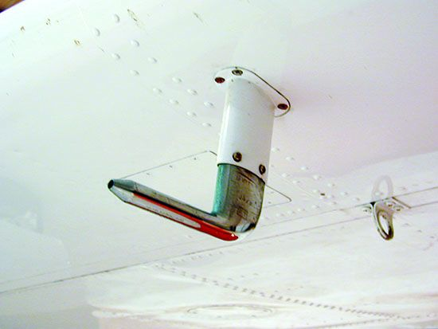
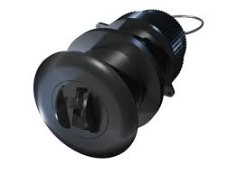
Speed Through Water
The speed of an object floating on water, affected by currents hitting the object.
Important for measuring trajectory of nautical navigation, as speed through water and speed on ground shows how the currents are affecting the boat.
Possible ideas to take information:
Pitot tube: Convenient in terms of measurements, but would require wiring to go underwater, raising the risk of failure.
Speed Transducer: Not as risky, however requires work to make it function properly, and is notably pricer.
Notes:
Speaker: Matt
Include: Why speed through water is important Current ideas we have for measuring speed through water Pros and cons of each?

Slide 16
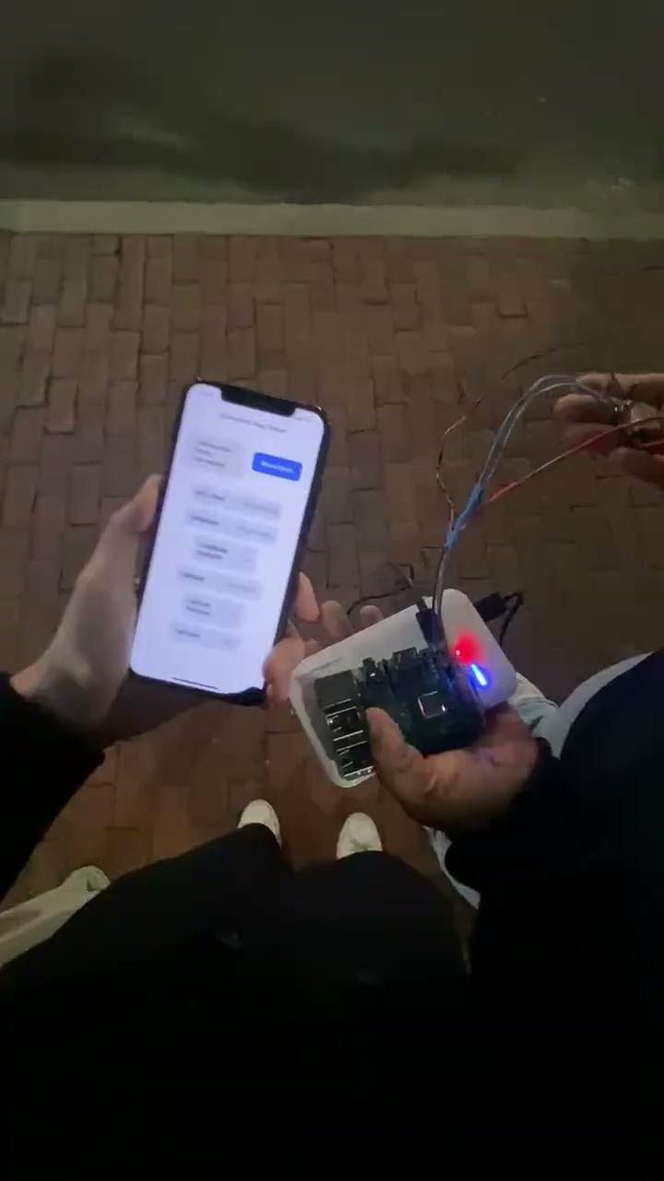
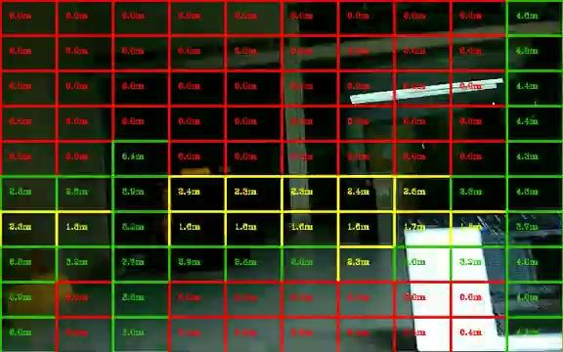
Prototype
Notes:
Speaker: Kyla (left), Kevin (right)
Insert Video, Photos, Drawings
MattG: Best photo/video would be a demonstration of the OAK-D camera. Maybe also the app but it only shows the GPS so not exactly the flashiest thing.

Slide 17
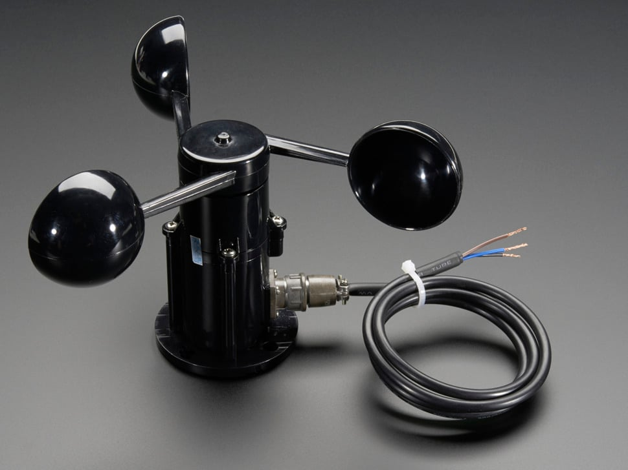
Anemometer
Sensor connected to a Raspberry Pi, sending wind speed and direction information constantly to the application.
Integral to the project due to the affect wind has on most boats. Gusts can derail a boat from projected route, thus using the information to make proper instructions to react to the wind is required.
Wind information will be recorded continuously and sent to the main Pi, and, alongside camera sensor information, suggestions will be made as to how to change course, if necessary.
Notes:
Speaker: Matt Anemometer: Sends data to the Raspberry Pi through wired connections, which is then sent to the application. The data sent includes wind speed and direction Include: Why anemometer(wind speed/wind direction) is important for our project Which anemometer module(s) we’re using and why

Slide 18
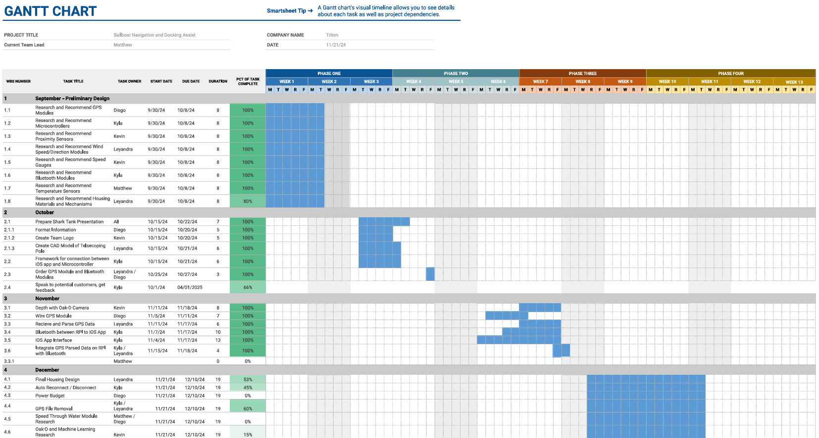
Fall Schedule
Notes:
Speaker:

Slide 19
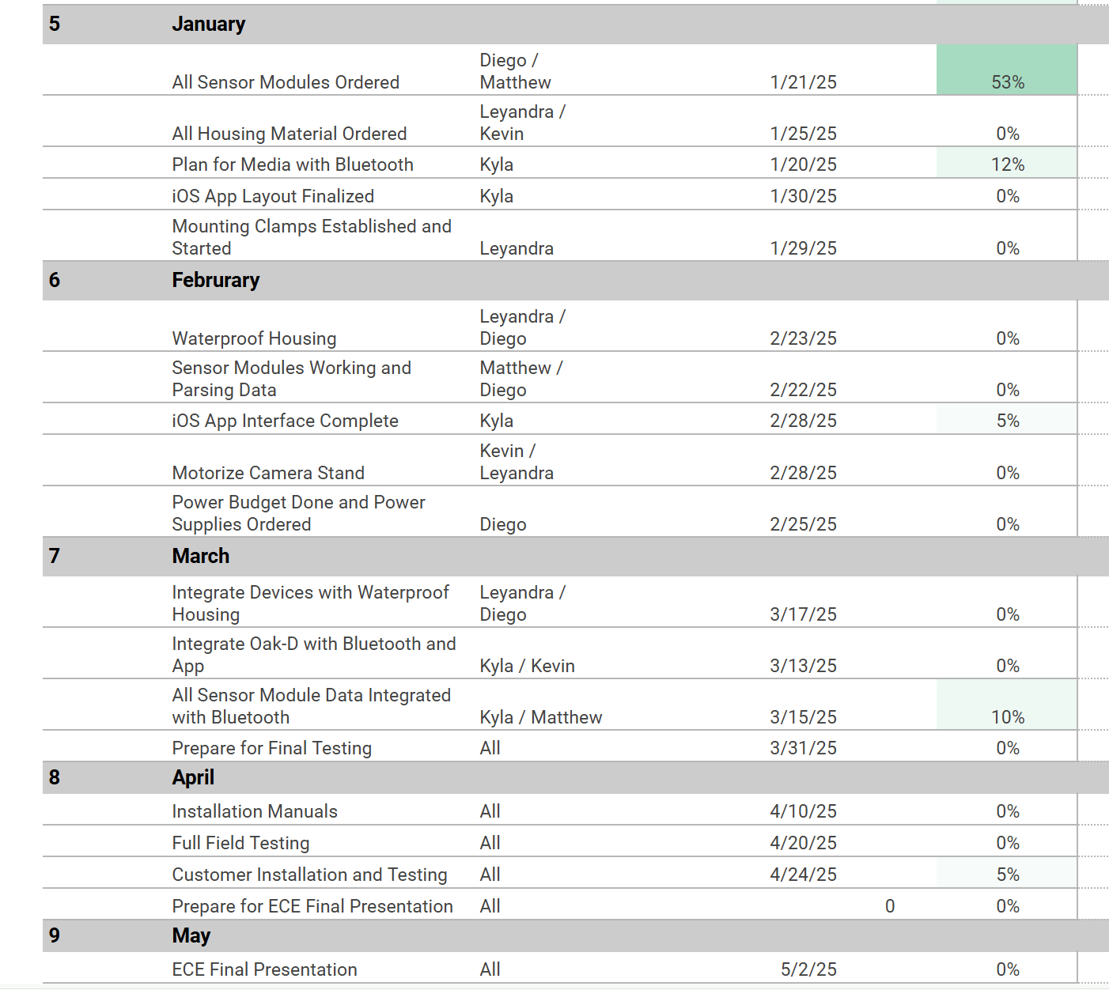
Spring Schedule
Notes:
Speaker:
We have a Gantt Chart But it needs to be detailed for next semester - Needs to be discussed

Slide 20
Thank You!
Notes:
Add in pictures from sailing

